Slide 1
AIML SUMMER INTERNSHIP 2026 · CAPSTONE PROJECT
Bengaluru House Price
Prediction System
A machine-learning pipeline that turns raw Bengaluru listings into
reliable, explainable price estimates.
IIHMF, MNNIT Allahabad

Slide 2
Problem Statement
Bengaluru's real-estate market is large, fragmented, and noisy. Prices swing sharply across micro-locations, area types, and layouts, making it hard for buyers, sellers, and agents to judge whether a quoted price is fair.
WHY IT MATTERS
13,320
real listings across Bengaluru used
to ground every prediction in data
Prices depend on non-linear combinations of location, size and amenities
No simple rule-of-thumb works across 13,000+ listings and dozens of localities
GOAL
Buyers and sellers lack a fast, data-backed reference price
Build a model that estimates price within a known, honest margin of error — and ship it as a usable app.
Bengaluru House Price Prediction
2

Slide 3
Objectives
1
Build the pipeline
2
Engineer signal
Turn 13,320 raw Bengaluru listings into a clean, model-ready dataset.
Derive bath_per_bhk and sqft_per_bhk to capture layout efficiency.
3
Compare algorithms
4
Ship a live app
Benchmark Linear Regression, Random Forest and XGBoost on the same test set.
Deploy the best model behind an interactive Streamlit interface.
Bengaluru House Price Prediction
3

Slide 4
Dataset Description
FEATURES IN THE RAW DATA
TOTAL LISTINGS
13,320
area_type
availability
Category of listing (built-up, plot, etc.)
Ready-to-move or possession date
rows of real Bengaluru
house listings
location
size
Locality / neighborhood in Bengaluru
Bedroom configuration (e.g. 3 BHK)
TARGET VARIABLE
society
total_sqft
price
Housing society / project name
Built-up area in square feet
in Lakh INR (₹)
bath
balcony
Number of bathrooms
Number of balconies
Bengaluru House Price Prediction
4

Slide 5
Methodology
An end-to-end pipeline, from raw CSV to a deployed prediction app.
1
2
3
4
5
6
Data
Collection
Preprocessing
Feature
Engineering
EDA
Model
Training
Deployment
Every stage is reproducible from a single script (bengaluru_pipeline.py), so the model can be retrained end-to-end as new listings arrive — preprocessing, feature engineering and evaluation all run in one pass before the app picks up the saved model artifact.
Bengaluru House Price Prediction
5

Slide 6
Data Preprocessing
Before a prediction is made, every input passes through four quiet safeguards.
1
Feature Engineering
Derives bath_per_bhk and sqft_per_bhk so the model reads layout efficiency, not just raw counts.
2
Categorical Formatting
Matches Location and Area Type to the model's trained categories; converts “Ready to Move” to binary (1 / 0).
3
Reality Checks
Flags unusual inputs — e.g. under 300 sqft for a 3 BHK, or more bathrooms than bedrooms.
4
Safety Guards
Clamps any unrealistic negative or near-zero output to a sensible minimum of ₹5 Lakh.
Bengaluru House Price Prediction
6

Slide 7
Exploratory Data Analysis
Univariate
Bivariate
Correlation Heatmap
Price and square-footage
histograms reveal skewed,
long-tailed distributions.
Price by area type (boxplot)
and sqft vs. price scatter,
colored by BHK count.
Numeric features (sqft, bath,
balcony, price) checked for
multicollinearity before modeling.
Bengaluru House Price Prediction
7

Slide 8
Models Used
Three algorithms, trained and scored on the same held-out test set.
BEST FIT
1
2
3
Linear Regression
Random Forest
XGBoost
Baseline model. Struggles to capture complex, non-linear pricing trends.
Ensemble of decision trees. Captures non-linear location patterns well.
Gradient-boosted trees. Best overall performance across every metric.
R² ≈ 0.72
R² ≈ 0.85
R² ≈ 0.88
Bengaluru House Price Prediction
8

Slide 9
Results
All models evaluated on the same unseen test dataset.
Model | R² Score | MAE (₹ Lakh) | RMSE (₹ Lakh) | Verdict
Linear Regression | ~0.72 | ~25.4 | ~45.1 | Baseline; struggles with non-linear trends
Random Forest | ~0.85 | ~19.8 | ~31.2 | Good at capturing non-linear location patterns
XGBoost ★ | ~0.88 | ~18.5 | ~29.3 | Best overall performance
R² Score
MAE
RMSE
How well the model explains price variation — higher is better. XGBoost explains ~88%.
Average error in Lakhs — lower is better. XGBoost is off by ~₹18.5L on average.
Penalizes large errors — higher than MAE shows a few big misses on luxury homes.
Bengaluru House Price Prediction
9

Slide 10
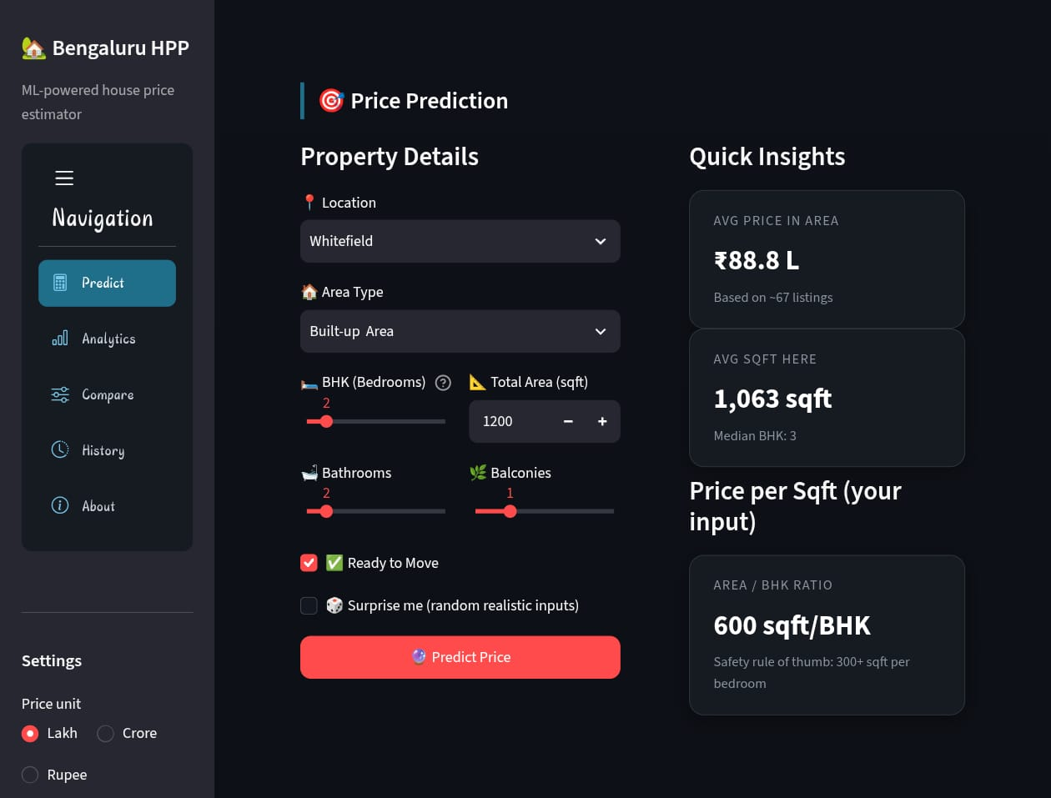
Demo — Live Prediction App
Streamlit interface: enter listing details, get an instant price estimate.
Bengaluru House Price Prediction
10

Slide 11
Conclusion
1
XGBoost delivered the best overall performance, explaining ~88% of price variance with the lowest error.
BEST MODEL
XGBoost
2
Engineered ratios (bath_per_bhk, sqft_per_bhk) gave the model real signal beyond raw feature counts.
R² SCORE
Validation and safety-guard logic keep predictions sensible even for atypical or extreme inputs.
0.88
3
MEAN ABSOLUTE ERROR
The full pipeline is deployed end-to-end as a live Streamlit app, ready for real users.
₹ 18.5 Lakh
4
Bengaluru House Price Prediction
11

Slide 12
Future Scope
1
2
3
Richer features
Deep learning
Deeper tuning
Property age, proximity to metro/tech parks, and amenity data for sharper estimates.
Explore neural approaches to capture subtler location and layout interactions.
Broader hyperparameter search and ensembling across model families.
4
5
6
Explainability
Cloud deployment
Continuous learning
Add SHAP-based explanations so users see why a price was predicted.
Move from local Streamlit to a managed cloud deployment with CI/CD.
Periodic retraining as fresh Bengaluru listings become available.
Bengaluru House Price Prediction
12

